Slide 1
Introduction to Geographical Information System
Raheel Abbas
GIS Analyst

Slide 2
Introduction to GIS
What is GIS?
G ? Geographical
I ? Information
S? System, Science, Studies

Slide 3
S in GIS?
S as in System
Technology (for acquiring and managing GIS data)
S as in Science
Concept behind the technology. Theoretical foundation on which GIS systems are based
S as in Studies
Societal context (social, legal, and ethical issues related to GIS application)

Slide 4
What is Geography?
“Geography is the study of the world's environment and man's interaction within the environment.”
Geography has two parts:
PHYSICAL:
The study of the earth's natural features, such as mountains, rivers, soil, vegetation, and weather
HUMAN: (Cultural)
The study of human cultures and man made features.
“All kinds of resources are used to study geography, but the most common are MAPS.”

Slide 5
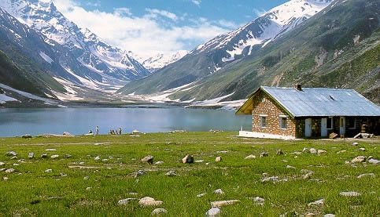

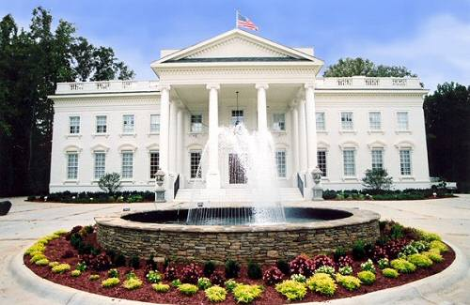

How an object on Earth can be defined?

Slide 6
How an object on Earth is explain?
Location Information: Where is it?
Attribute Information: What is it?
Type
…….
X^{O}South, Y^{O}West
Species
…….
Heights
…….
Use
…….
GIS can tell us Where and What
Notes:
Geospatial data tells you where it is and attribute data tells you what it is. Metadata describes both geospatial and attribute data

Slide 7
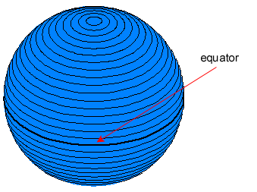
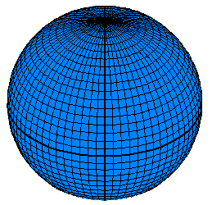
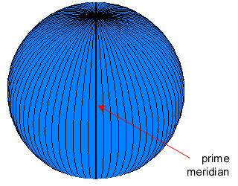
Positions on Globe: Lines of Reference
Figure: 1
graticules
Figure: 3
Figure: 2
Notes:
7
1:parallels of latitude (Y)
2:meridians of longitude (X)
3:graticular network

Slide 8
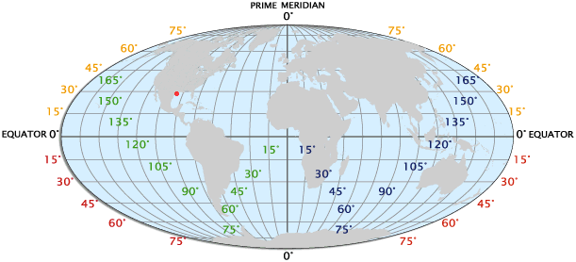
Geographic Coordinate System (GCS)
GCS uses a three-dimensional spherical surface to define locations on the earth.
Latitude and Longitude are angles denoted by ( °, ', " )

Slide 9
Why GIS is Important?
What is Where? :
Query information to find location
Or
Where is what?
Obtain information from a location
Notes:
What is Where?
At which pole polar bear lives?
Where you may find rain forest?
Where is what?
At North Pole what dominant land animal is found?
At tropical region what type of forests are found?

Slide 10
GIS is about Geospatial Information
Geography/Geospatial: Information about places on earth
Not only Where and What but time is also important
What is Where, When?

Slide 11
GIS…
A GIS is not simply a computer system for making pretty maps. More importantly a GIS...
... is an analysis tool
... links spatial data with geographic information about a particular feature on a map
... can use the stored attributes to compute new information about map features
Notes:
Source of this slide: Tim Haithcoat

Slide 12
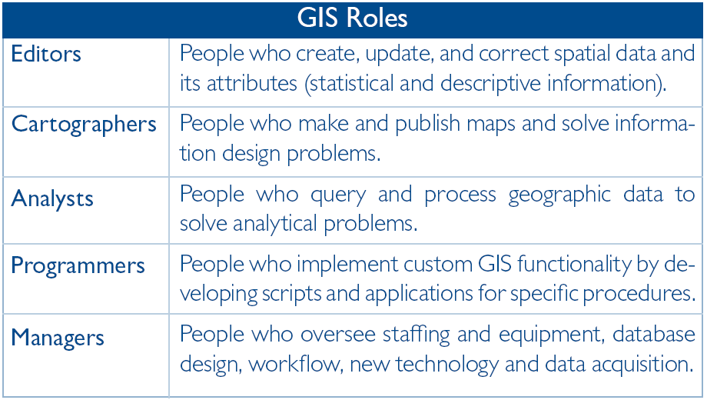
Notes:
Source: sample/pdf
What exactly does a GIS analyst do and how is that job different from other jobs that also use GIS software? This table define the some of the various roles that a typical GIS operation might establish to accomplish their work.

Slide 13
Government
Natural Resources
Agriculture
Utilities
GIS Application Sectors
Engineering
Transportation
Cities
Security/Emergency

Slide 14
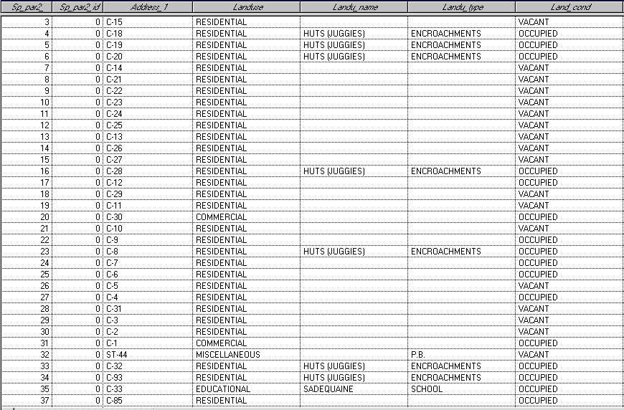
Conventional Ways to Store Data
DATABASES
A Database comprises of tables having fields with specific data structure.
The tables are linked with each other through various common fields.
Data

Slide 15
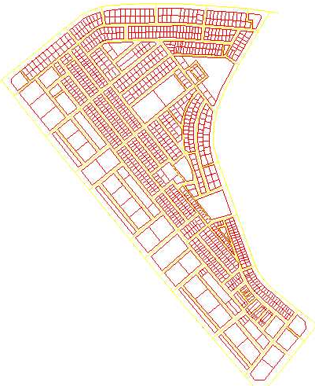
Conventional Ways to Store Data
MAPS
Map can be defined as “A Facility for displaying interpretation of geographic information on a flat surface.”
Location information describes the position of a particular geographic feature on earth's surface & provides the basis for representing spatial relationships between these features.
Map

Slide 16
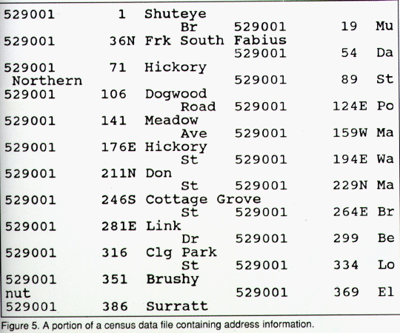
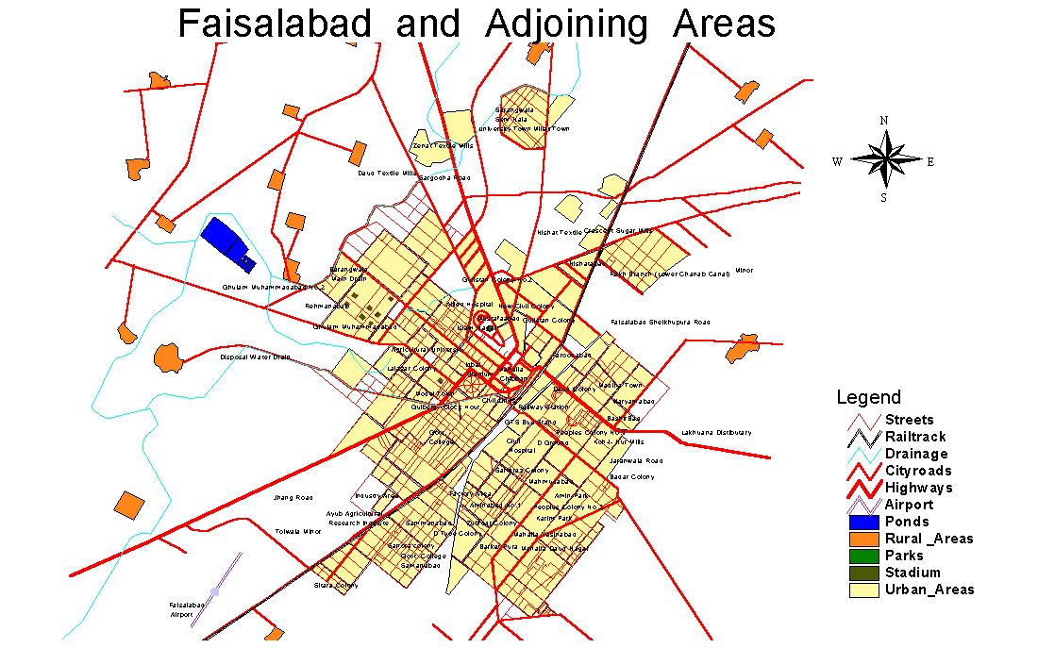
Databases vs Maps
Very good
Searching
Bad
Searching
What? if link
together
Bad
Visual Interpretation
Very Good
Visual Interpretation

Slide 17
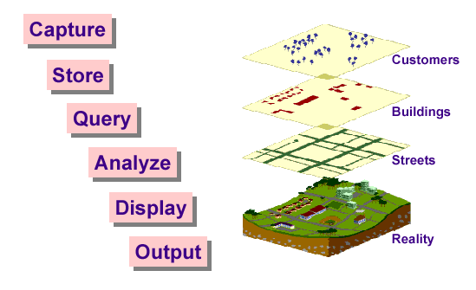
Basic GIS Function

Slide 18
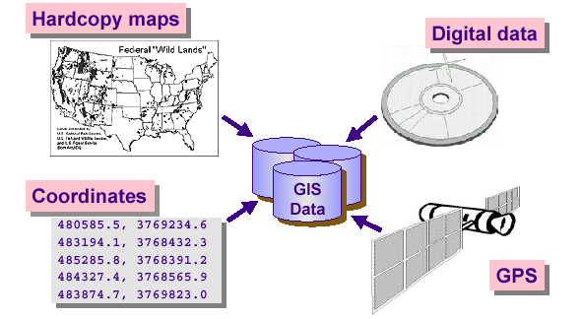
GIS Function
Data Capturing

Slide 19
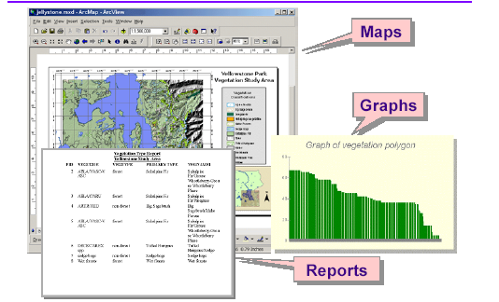
GIS Function
Display

Slide 20
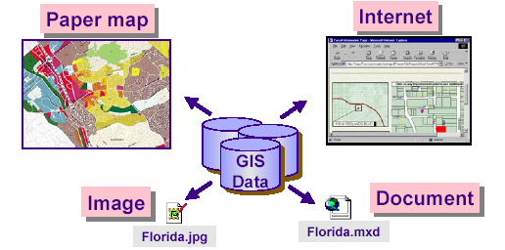
GIS Function
Output

Slide 21
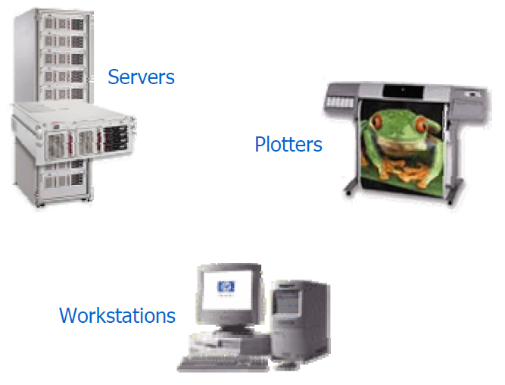
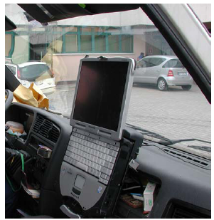
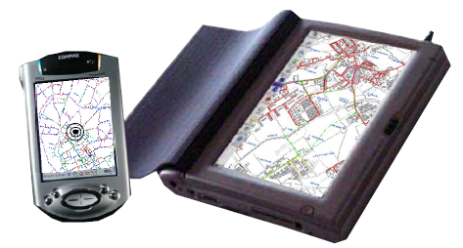
GIS Component
Hardware
Hardware is the computer system on which software operates

Slide 22
GIS Component
Software
Key components to GIS software:
An easy-to-use graphical user interface (GUI)
Tools for entering and manipulating geographic information
Tools that support geographic query, analysis and visualization
A database management system (DBMS)

Slide 23


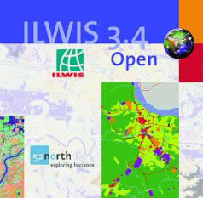

Geographical Information System (GIS)

Slide 24
Geographical Information System (GIS)

Slide 25
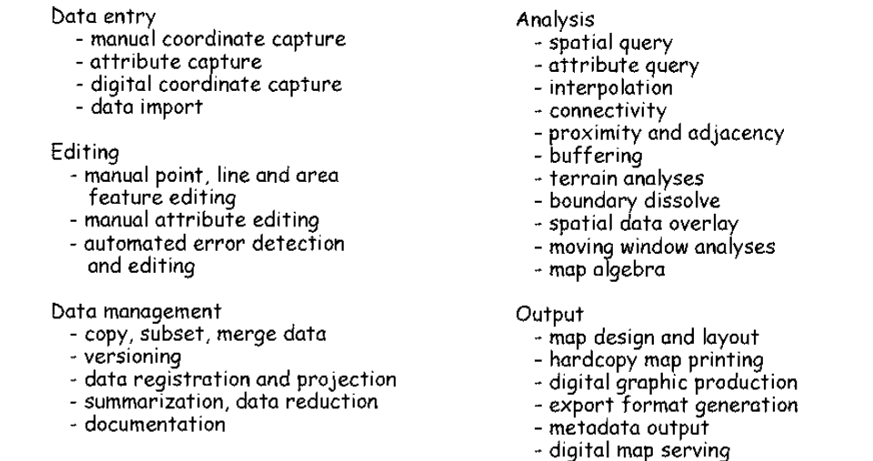
Functions Provided by GIS Software
Reference: Bolstad, 2008

Slide 26
Map Projection
Converting the 3D Model to 2D Plane
Notes:
26

Slide 27
Map Projection
Earth is 3-D object
The transformation of 3-D Earth’s surface coordinates into 2-D map coordinates is called Map Projection
A map projection uses mathematical formulas to relate spherical coordinates on the globe to flat, planar coordinates
Notes:
27

Slide 28
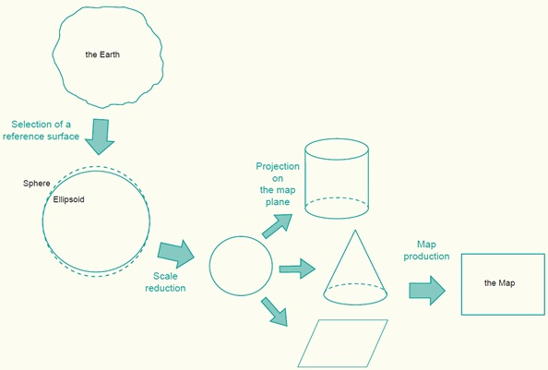
Projecting Earth's Surface into a Plane

Slide 29
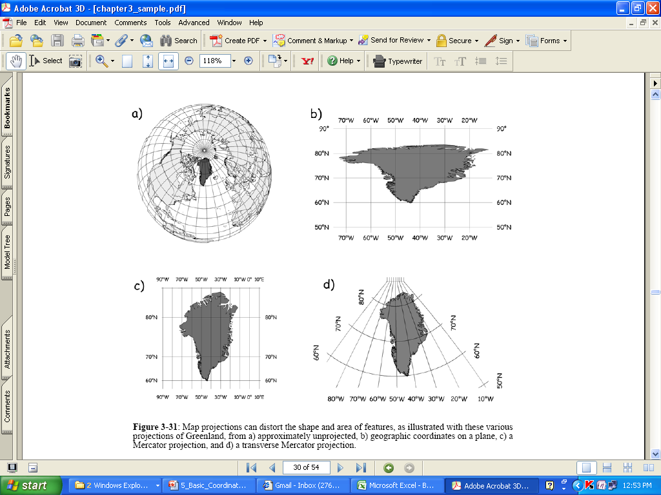
Notes:
Source: Text book

Slide 30
GIS Data Models
Two Primary data models
Vector Data Model
Edges and vertices are defined by series of coordinate pairs (x, y) and connected by arcs
Raster Data Model
Map area is divided into grid cells
Each cell contains a value (Categorical or Quantitative values)

Slide 31
GIS Data Representation
Real world entities are approximated with spatial objects or features
Entities are “things” in real world
Rivers
Roads
Land use

Slide 32
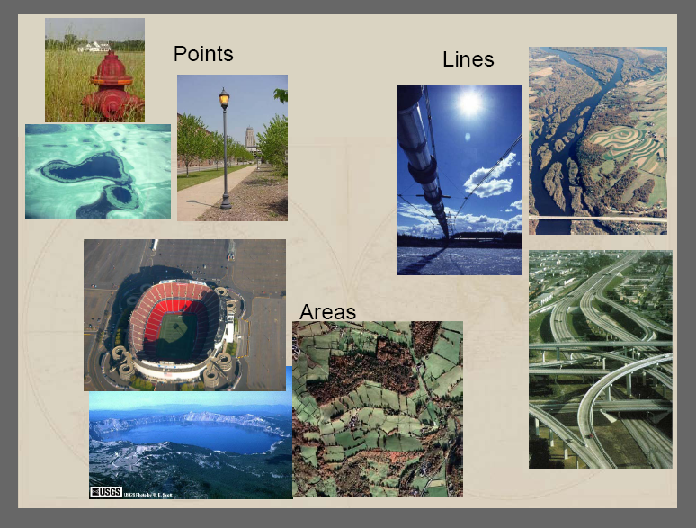
GIS Data Representation

Slide 33
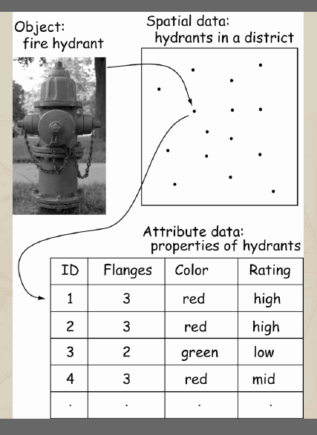
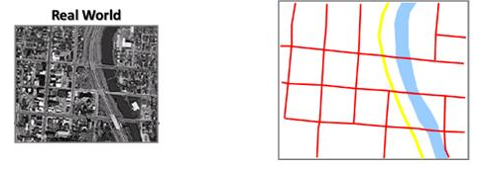
Representation of entities
Examples
Fire Hydrant: by location points
Roads: by series of straight lines connected at nodes
Lakes: can be represented by set of polygons

Slide 34
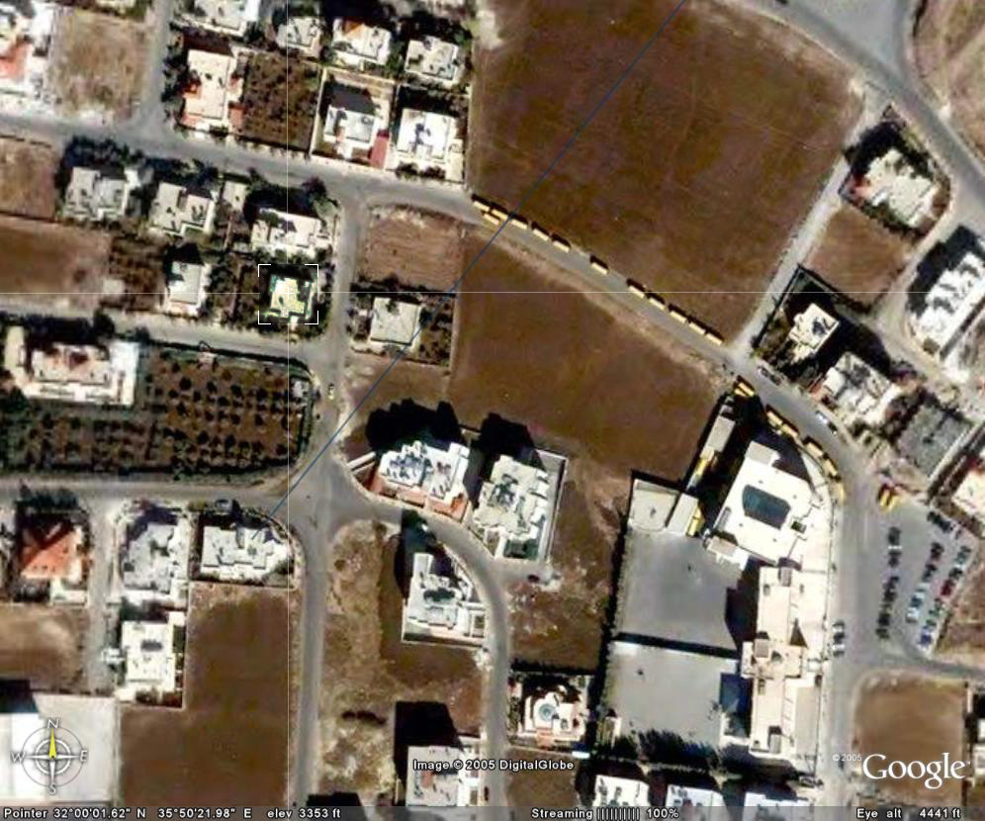
Representation of GIS Data Model

Slide 35
Representation of GIS Data Model
Legends
Buildings
Land
Road

Slide 36
Representation of GIS Data Model
Points
Buildings, fire hydrants, location of accidents, traffic signals, etc.
Lines
Roads, pipelines, rivers, water mains, traffic routes, etc.
Polygons
Land parcels, lake, countries, etc.
Notes:
A point normally represents a geographic feature too small to be displayed as a line or area.
Line: shape of geographic features too narrow to be displayed as an area at the given scale (contours, street centerlines, or streams), or linear features with no area. More complex lines made up of many line segments.
Polygon: A feature used to represent areas.

Slide 37
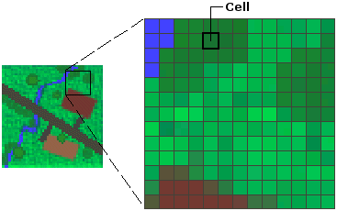
Raster Data Model

Slide 38
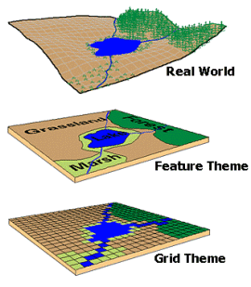
Representing the Earth
VECTOR
RASTER

Slide 39
Data Models
Notes:
There are instances when working with vector tools and formats is the best practice, and instances when working with raster tools and formats is the best practice. There are times when both formats come together.
Which one is better? Nature of the data and the processing desired determines the appropriate data structure.

Slide 40
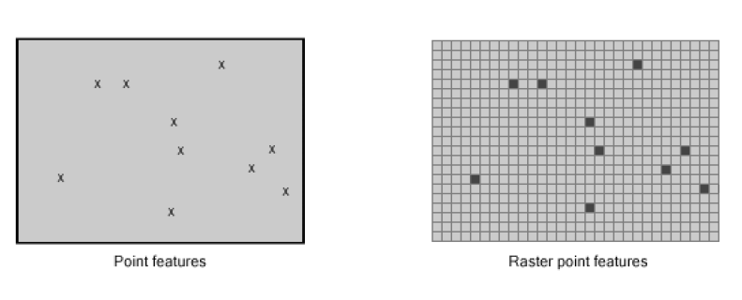
Representing Point Features

Slide 41
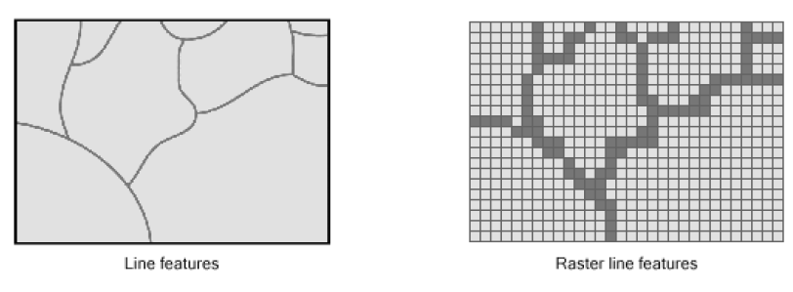
Representing Line Features

Slide 42
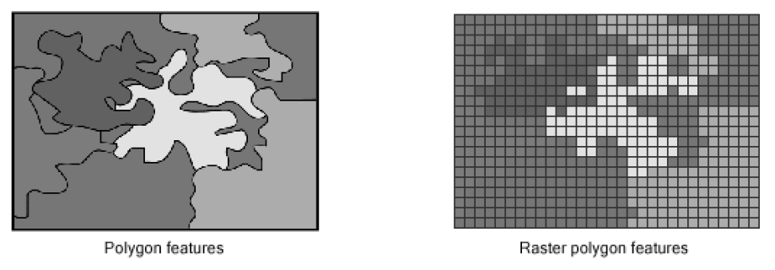
Representing Polygon Features

Slide 43
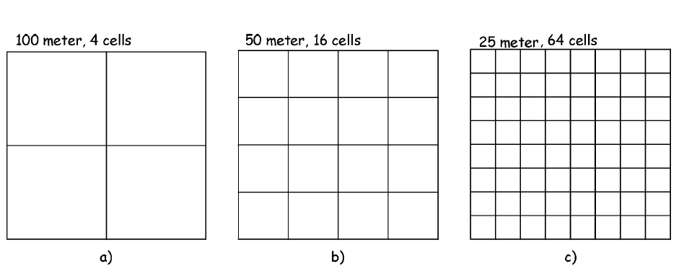
Grid Size and Resolution
Notes:
For a given area, a linear decrease in cell size cause an exponential increase in cell number,

Slide 44
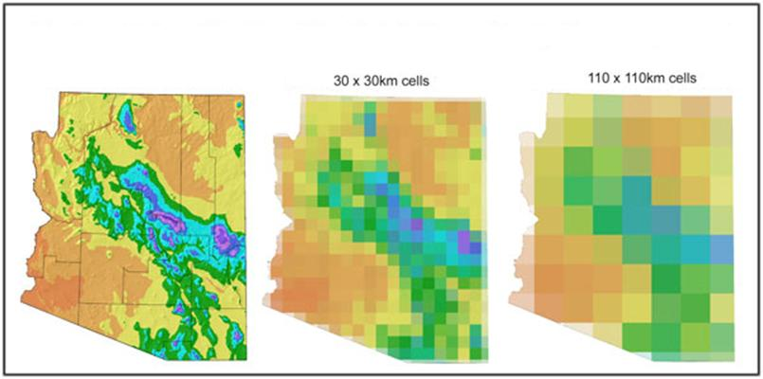
Grid Size and Resolution
Notes:
For a given area, a linear decrease in cell size cause an exponential increase in cell number,

Slide 45
Examples of Raster
Digital aerial photographs
Imagery from satellites
Digital pictures
Scanned maps

Slide 46
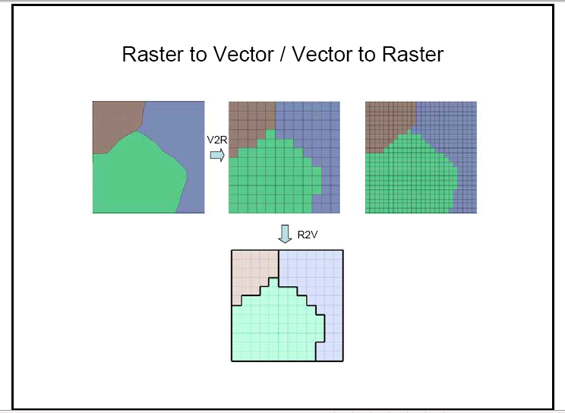
Source: http://web.pdx.edu/~jduh/courses/geog492w09/Week2b.pdf

Slide 47
Vector to Raster (V2R)
Assign a cell value for each position occupied by vector features
Notes:
The cell in which the point resides is given a number or other code identifying the point feature occurring at the cell location.

Slide 48
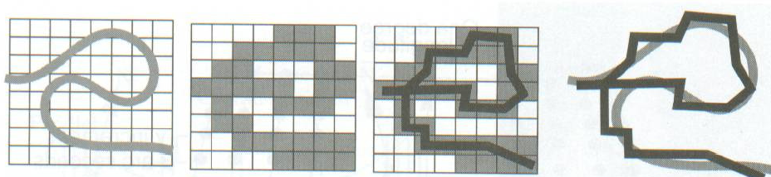
R2V - Conversion Errors
Example:
Vector to raster conversion generally involves a loss in precision
Notes:
The original river after R2V conversion appears to connect the loop back.
Deletion of small features e.g. small polygons may by lost?

Slide 49
